Slide 1
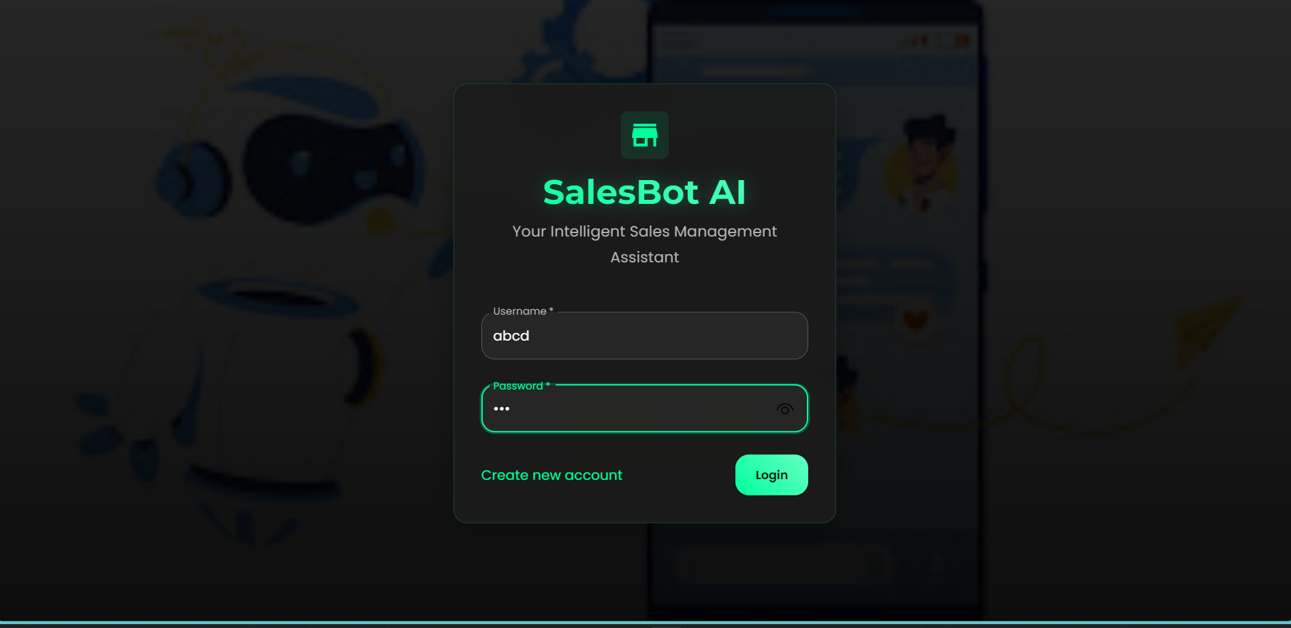

AI-Powered Sales Assistant Chatbot
Streamlining E-commerce Product Management

Slide 2
Project Overview & Problem Statement
What is the problem?
Manual product management can be inefficient for e-commerce.
Need for an intuitive way to manage inventory and sales interactions.
Traditional UIs can be cumbersome for quick operations.
Our Solution: An AI-powered chatbot offering command-line like efficiency with a friendly chat interface.

Slide 3
Technology Stack
Frontend: React.js, Material-UI, JavaScript (ES6+)
Why these? Component-based, modern UI, rich ecosystem.
Backend: Python (Flask), Flask-SQLAlchemy, Flask-Bcrypt, Flask-CORS
Why these? Lightweight, flexible, strong for APIs, secure authentication.
Database: SQLite (local development)
Why this? Ease of setup, good for rapid prototyping

Slide 4
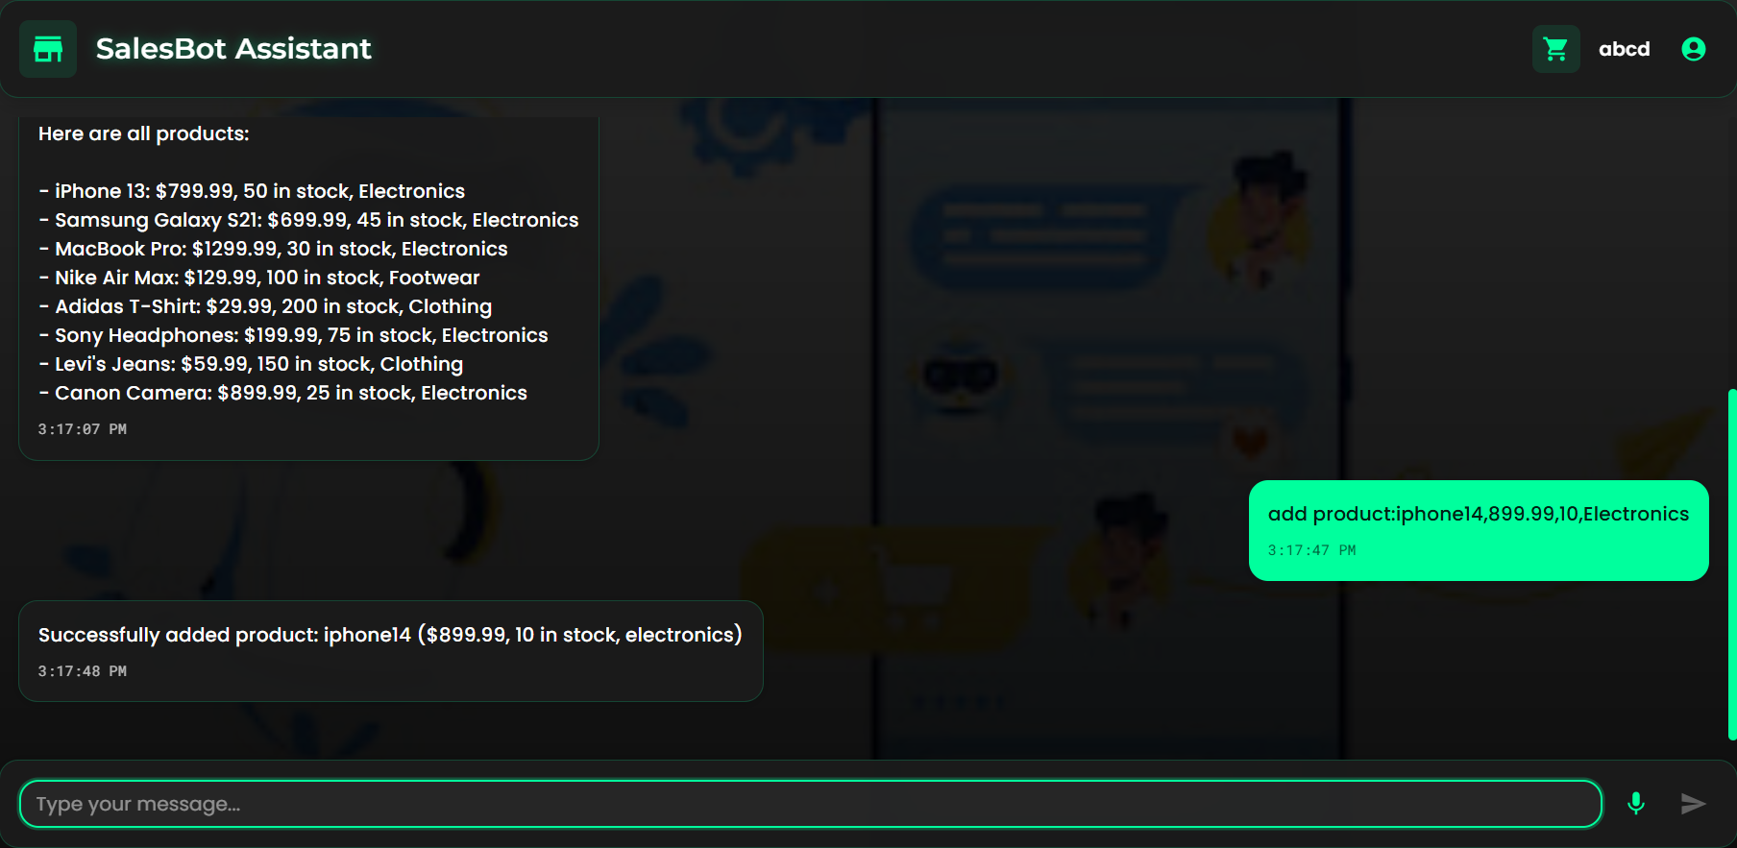
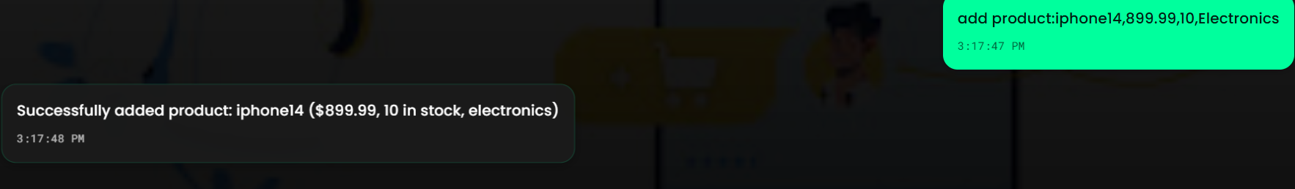
Key Features
User Authentication: Login/Registration (Brief mention of security: password hashing)
Intuitive Chat Interface: Show the chat window.
Welcome Message: Demonstrate the personalized, formatted welcome message on login.
Product CRUD Operations
Add Product: add product: [name], [price], [quantity], [category]
Show sample input and the "Product added successfully!" output.
Search Product: search [keyword]
Show sample input and the search results list.
Update Product: update product: [name], [field], [value]
Show sample input and the "Product updated successfully!" output.
Delete Product: delete product: [name]
Show sample input and the "Product deleted successfully!" output.
Show All Products: show all products
Show the list of all products.
Show by Category: category [categoary_name]
Show filtered products.
Chat History Persistence: Briefly mention how messages are saved and loaded.

Slide 5
Challenges Faced & Solutions
Problem 1: Infinite Welcome Message Loop
Solution: hasShownWelcome state flag and conditional rendering.
Problem 2: Input Not Being Taken
Solution: Correct state binding, robust event handling, and extensive logging for debugging.
Problem 3: Message Formatting Issues
Solution: whiteSpace: 'pre-wrap' on display components and explicit newline characters (\n).
Problem 4: UI/UX Consistency
Solution: Re-establishing Material-UI styled components, careful prop handling.

Slide 6
Thank you

